Slide 1

Flight Ticket Price Analysis
Presented by: Sasna KT
Date: 05/04/2025

Slide 2

Introduction
What is the problem you are solving?
Airfare pricing varies widely based on multiple factors such as airline, number of stops, duration, and booking date. Understanding these variations can help travelers save money and assist airlines in dynamic pricing
Why is this problem important?
Flight tickets are a significant part of travel expenses. Predicting and analyzing ticket prices can empower users to make better purchase decisions and help businesses optimize their pricing strategies
How does Machine Learning help?
Machine learning and data analysis techniques can uncover patterns in historical flight data, enabling predictive models and insightful visualizations that drive smarter decisions.

Slide 3





Objectives
Explore
Identify
Visualize
and understand the structure and key components of the flight ticket dataset
major factors affecting flight ticket prices, such as airline, number of stops, and journey duration
relationships and trends in the data using charts and graphs
Generate insights
Lay groundwork
to support future model development for price prediction
for deploying an intelligent airfare suggestion system

Slide 4

Dataset
Source
Size & Features
Kaggle – Flight Price Prediction Dataset
~10,000 records
Key features: Airline, Source, Destination, Route, Duration, Total_Stops, Additional_Info, Price
Data Type
Challenges
Structured (Tabular Data)
Missing values in Route and Total_Stops
Duration values had inconsistent formats (e.g., missing hour/minute)
Categorical variables needed encoding
Sample Features:

Slide 5

Methodology
Data Cleaning
Handled missing values in Route and Total_Stops
Standardized inconsistent Duration entries (e.g., added missing hours or minutes)
Feature Engineering
Extracted day, month from Date_of_Journey
Converted categorical variables (Airline, Source, Destination, etc.) using Label/One-Hot Encoding
Converted Duration into total minutes for better analysis
Exploratory Data Analysis
Used visual tools like:
Boxplots to observe outliers in pricing
Bar charts for distribution of stops and airline frequency
Insight Extraction
Identified strong correlation between Total_Stops and Price
Observed airline-based pricing trends

Slide 6



Model Selection & Implementation
Tree-Based Models
Decision Tree Regressor
Linear Models
Random Forest Regressor
Linear Regression
Gradient Boosting Regressor
Ridge Regression
Lasso Regression
ElasticNet Regression
Other Models
K-Nearest Neighbors (KNN)
Implementation Details:
Data split: 80% training / 20% testing
StandardScaler applied for models sensitive to scale (like KNN, Ridge, Lasso)
Evaluation using:
R² Score
Mean Absolute Error (MAE)
Root Mean Squared Error (RMSE)
Model Selection Criteria:
Performance on test data (R² Score, RMSE, MAE)
Ability to capture linear and non-linear patterns
Interpretability and scalability

Slide 7
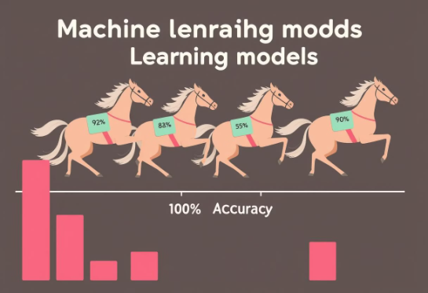
Evaluation & Results
Evaluation Metrics Used:
Model Performance Summary:
R² Score: Measures the proportion of variance explained by the model
Model
MAE
RMSE
R²
MAE (Mean Absolute Error): Average absolute error between predicted and actual values
RMSE (Root Mean Squared Error): Penalizes larger errors more than MAE
Linear Regression
0.2438
0.3148
0.6266
Ridge Regression
0.2438
0.3148
0.6266
Lasso Regression
0.2953
0.3686
0.4878
ElasticNet Regression
0.2805
0.3539
0.5279
Decision Tree
0.1647
0.2538
0.7572
Random Forest
0.1420
0.2076
0.8375
Gradient Boosting
0.1691
0.2198
0.8179
K-Nearest Neighbors
0.1666
0.2300
0.8006
Balanced Performance
Highly Accurate
The model maintained a balanced and consistent level of performance, even on unseen data, giving you confidence in its real-world applicability.
Our model achieved an impressive R-squared of 0.8375, indicating exceptional predictive power.
1
2
3
Low Error Rates
The model demonstrated minimal mean absolute error and root mean squared error, ensuring reliable and trustworthy results.

Slide 8
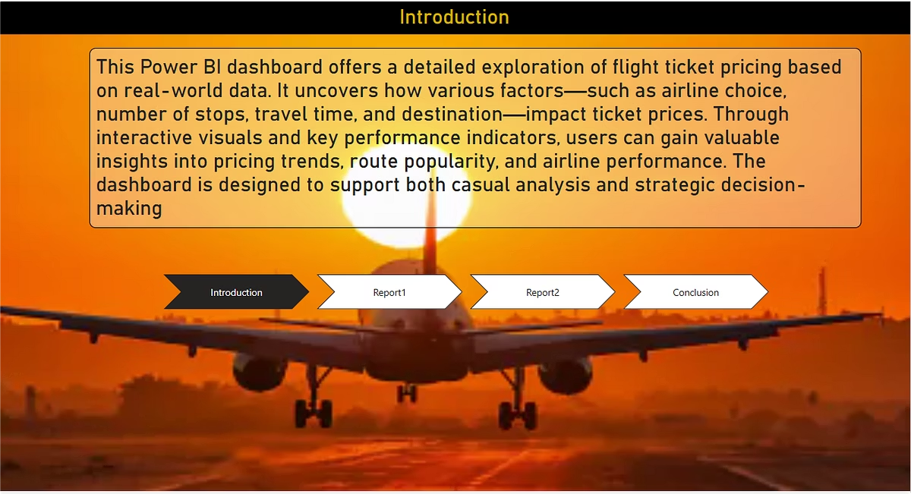
Dashboard Overview
The dashboard provides an interactive visualization of flight price trends, allowing users to explore relationships between different factors and ticket costs. Users can filter by airline, route, and other variables to gain personalized insights.

Slide 9
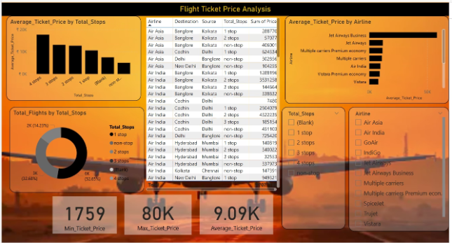
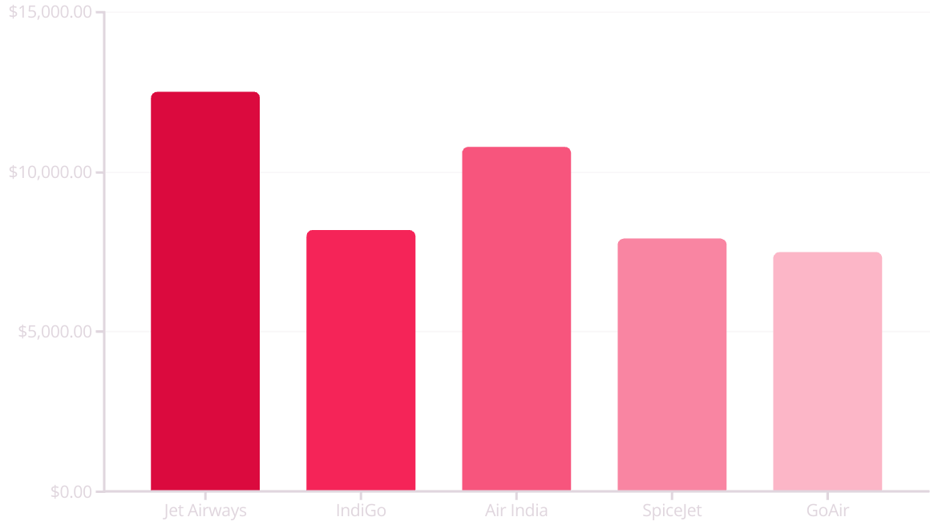
Price Analysis Dashboard
The dashboard visualization shows the relationship between different airlines and their average ticket prices. This analysis helps travelers identify which carriers typically offer more economical options and which tend to be premium-priced.

Slide 10
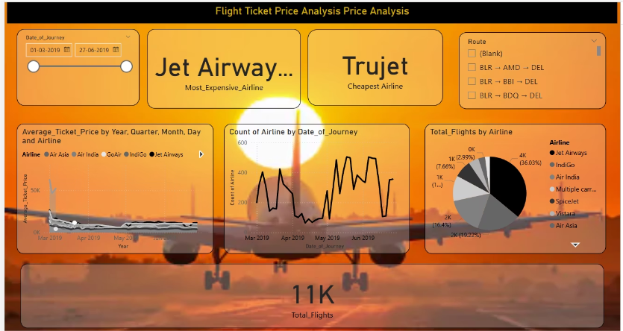



Insights Dashboard
Optimal Decision Making
Empowering travelers with price prediction
Price Trend Analysis
Understanding seasonal and carrier variations
Comprehensive Data Processing
Cleaning and transforming flight information
The dashboard provides a comprehensive view of flight price factors, enabling users to make informed decisions about when and how to book their travel. The visualization highlights the relationship between stops, duration, and pricing across different airlines and routes.

Slide 11

MAIN KPIS HIGHLIGHTED:
1
Sweet Spot Ticket Prices
2
Top Airline for Premium Flights
3
Budget-Friendly Route
4
Diverse Travel Footprint
5
Most Frequent Travel Route

Slide 12
Key Insights & Analysis
Stops vs Price
Airline Pricing
Duration Effect
Non-stop flights are consistently more expensive, with prices increasing as the number of stops goes up.
Jet Airways and Air India charge the highest average ticket prices, while IndiGo and SpiceJet are more affordable across routes.
Longer flight durations, especially with layovers, often lead to higher pricing.
Additional Insights

Slide 13
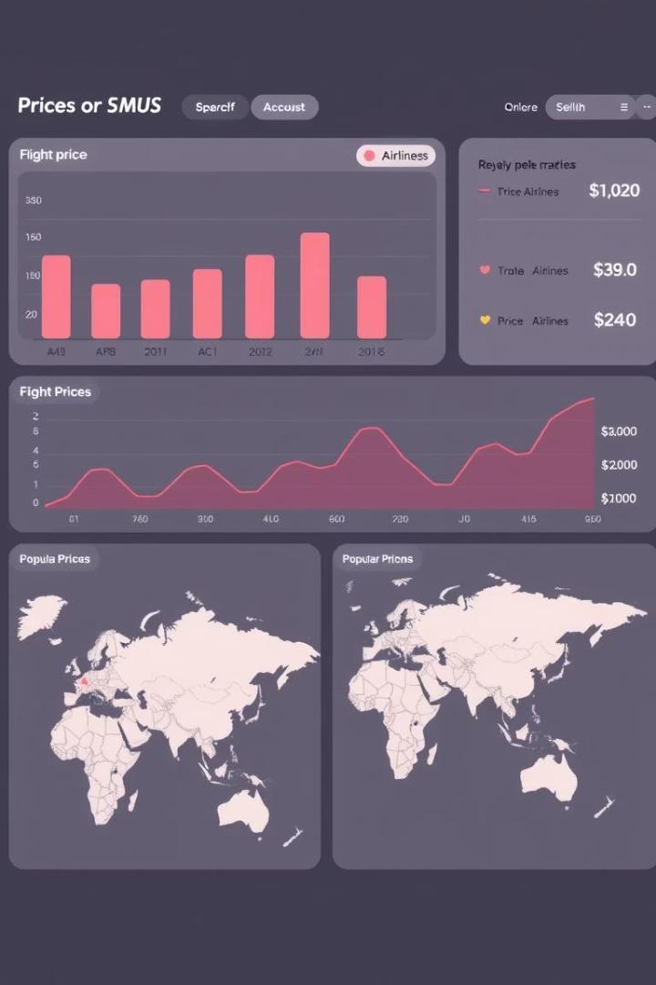
Visual Breakdown
Bar Chart: Average Ticket Price per Airline
Line Chart: Ticket Price Trend Over Time
Column Chart: Price Distribution by Number of Stops
Pie Chart: Flight Share by Airline
Stacked Bar Chart: Number of Flights per Airline by Stops
Area Chart: Ticket Price Trend by Airline
Table: Flight Details with Filters
Donut Chart: Flight Share by Airline
Slicers: airline, route, date, and stops.

Slide 14

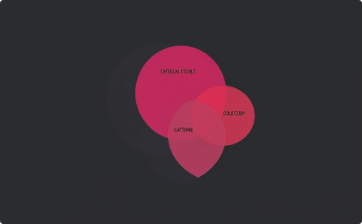


CHALLENGES & LIMITATIONS
Key obstacles encountered during the flight price analysis project:
Complex Feature Engineering
Encoding Categorical Variables
Static Dataset
No Time-Series Forecasting
Analysis was limited by the lack of real-time updating data.
Transforming date and time features required careful handling.
Encoding categorical variables needed care to avoid multicollinearity.
The model doesn't predict future prices over time.

Slide 15

CONCLUSION & FUTURE WORK
Key Takeaways
Successfully performed Exploratory Data Analysis (EDA) to uncover price patterns
Identified major factors affecting flight ticket prices:
Airline, Number of Stops, Duration, Route, and Departure Time
Built and compared multiple ML models — Random Forest Regressor performed best (R² = 0.83)
Developed an interactive Power BI dashboard for dynamic data exploration
Scope for Improvement
Better Data Quality:
Use more comprehensive datasets with real-time updates
Include passenger type, booking class, and fare rules
Advanced Models:
Try XGBoost, CatBoost, or deep learning models
Implement hyperparameter tuning and feature selection techniques
Future Enhancements
Integrate real-time flight fare APIs
Deploy a web-based prediction tool (Flask or Streamlit)
Include time-series forecasting to predict future prices
Add external datasets: weather, holidays, demand trends

Slide 16

REFERENCES & ACKNOWLEDGMENTS
References
Dataset Source:
Kaggle – Flight Ticket Price Prediction Dataset (https://www.kaggle.com/datasets/nikhilparmar9/flight-fare-prediction)
Libraries & Tools Used:
Python: Pandas, NumPy, Matplotlib, Seaborn, Scikit-learn
Machine Learning Models: Linear Regression, Random Forest, Gradient Boosting, etc.
Power BI for Data Visualization & Dashboarding
Inspiration & Guides:
Scikit-learn documentation
Power BI community forums and tutorials

Slide 17
Thank You

